Slide 1


Application of Deep Learning on the Characterization of Tor Traffic using Time based Features
Gal Bar
Yishay Garame
Naor Maoz

Slide 2


What is TOR?
The Onion Router (Tor) is a popular network, widely used by both political dissidents and cyber criminals alike. Tor attempts to circumvent government censorship and surveillance of individuals by keeping secret a message’s sender/receiver and content.

Slide 3
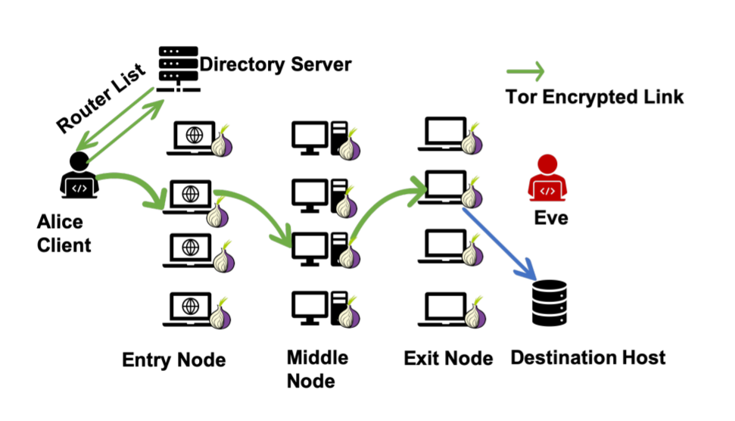
TOR Routing

Slide 4
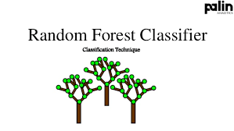
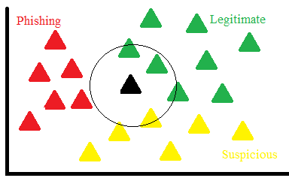
Abstract
The Article work compares the performance of various traditional machine learning algorithms (e.g. Random Forest, Decision Tree, k-Nearest Neighbor) and Deep Neural Networks on the ISCXTor2016 time-based dataset in detecting Tor traffic.
The research examines two scenarios: the goal of Scenario A is to detect Tor traffic while Scenario B’s goal is to determine the type of Tor traffic as one of eight categories.

Slide 5

Article Results
Scenario A demonstrate high performance, with classification accuracies > 99%.
Scenario B yielded a wider range of classification accuracies (40-82%)

Slide 6
Article Results - Scenario B
Scenario B yielded a wider range of classification accuracies (40-82%)
From the authors :
Scenario B seemingly lack enough diversity within the data to accurately classify > 40% of testing samples.

Slide 7
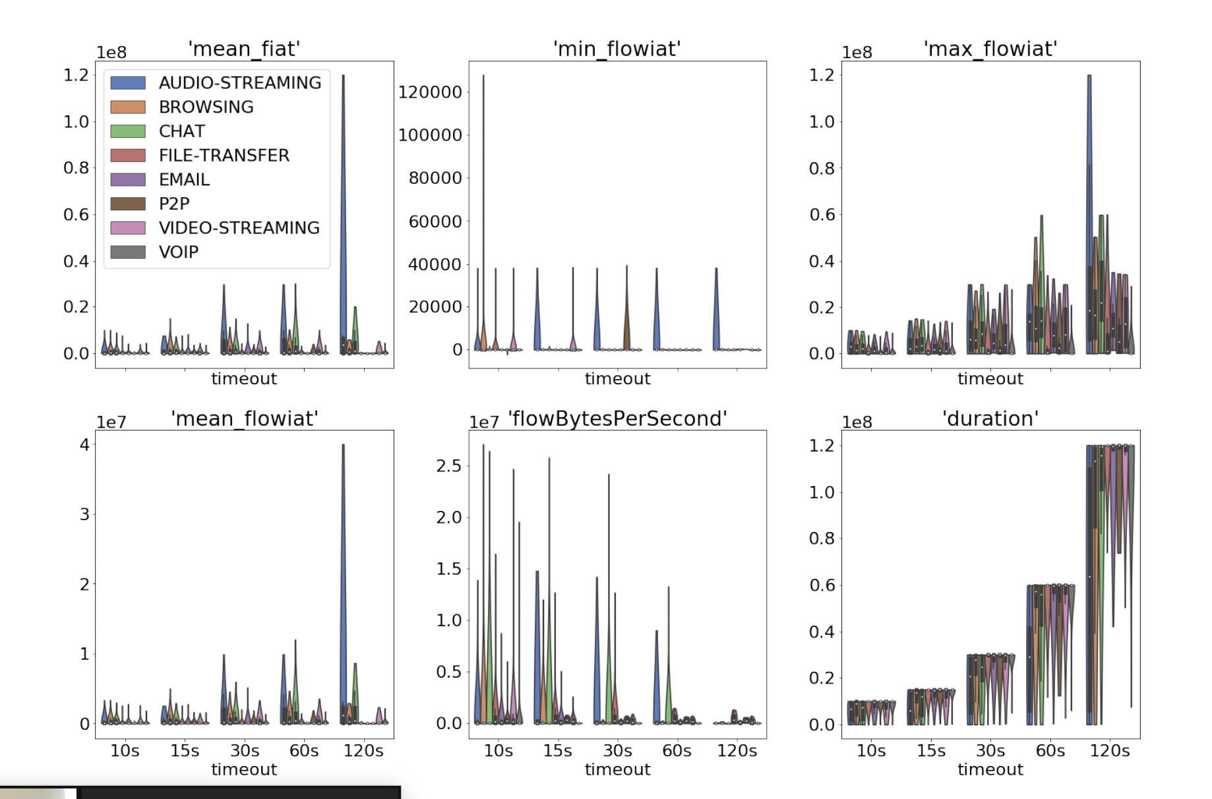
Article Results - Scenario B cons
“For Scenario B, the graphs of the distribution of the features clearly shows the source of the difficulty the models are experiencing when classifying across all eight categories”

Slide 8
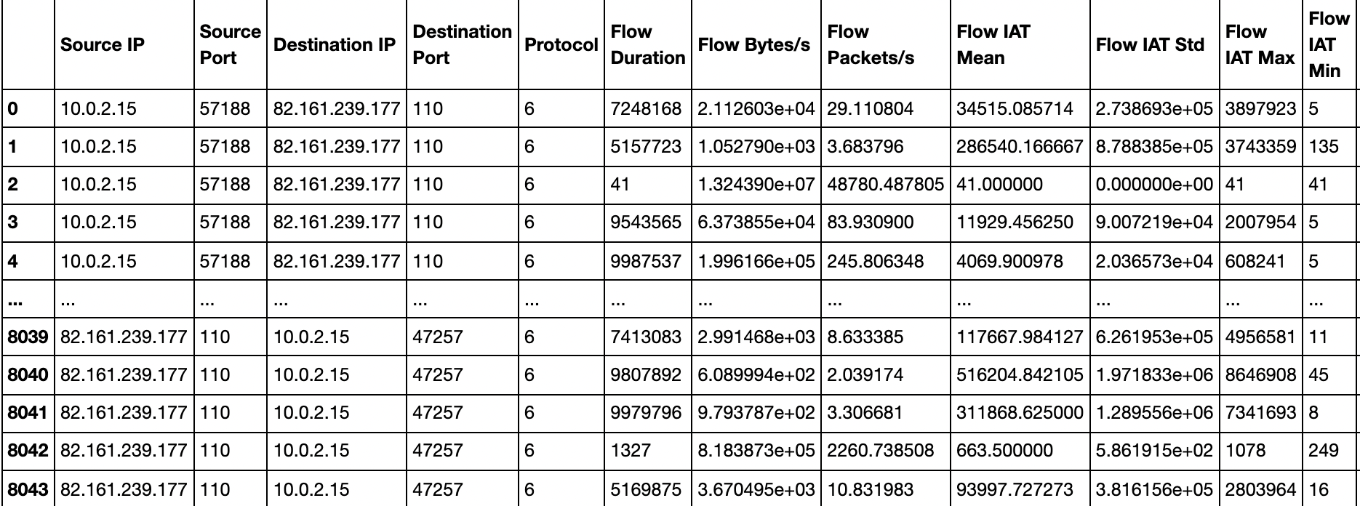
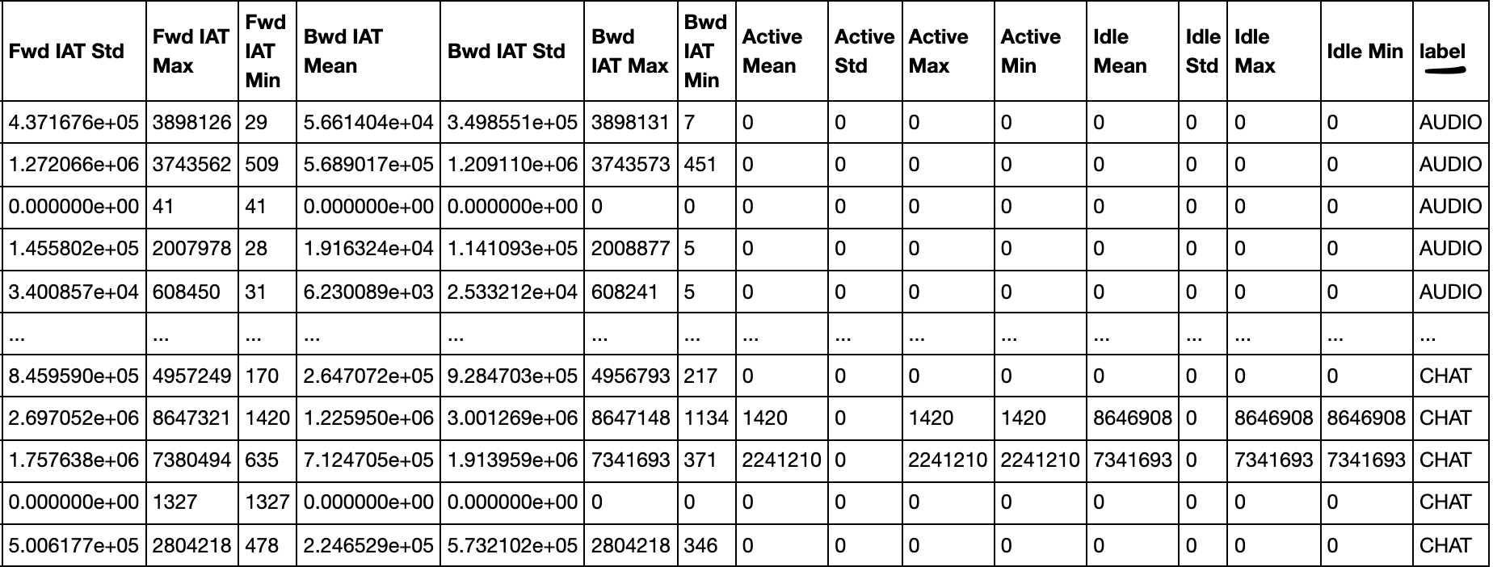
Data Exploration
8044 rows × 29 columns

Slide 9
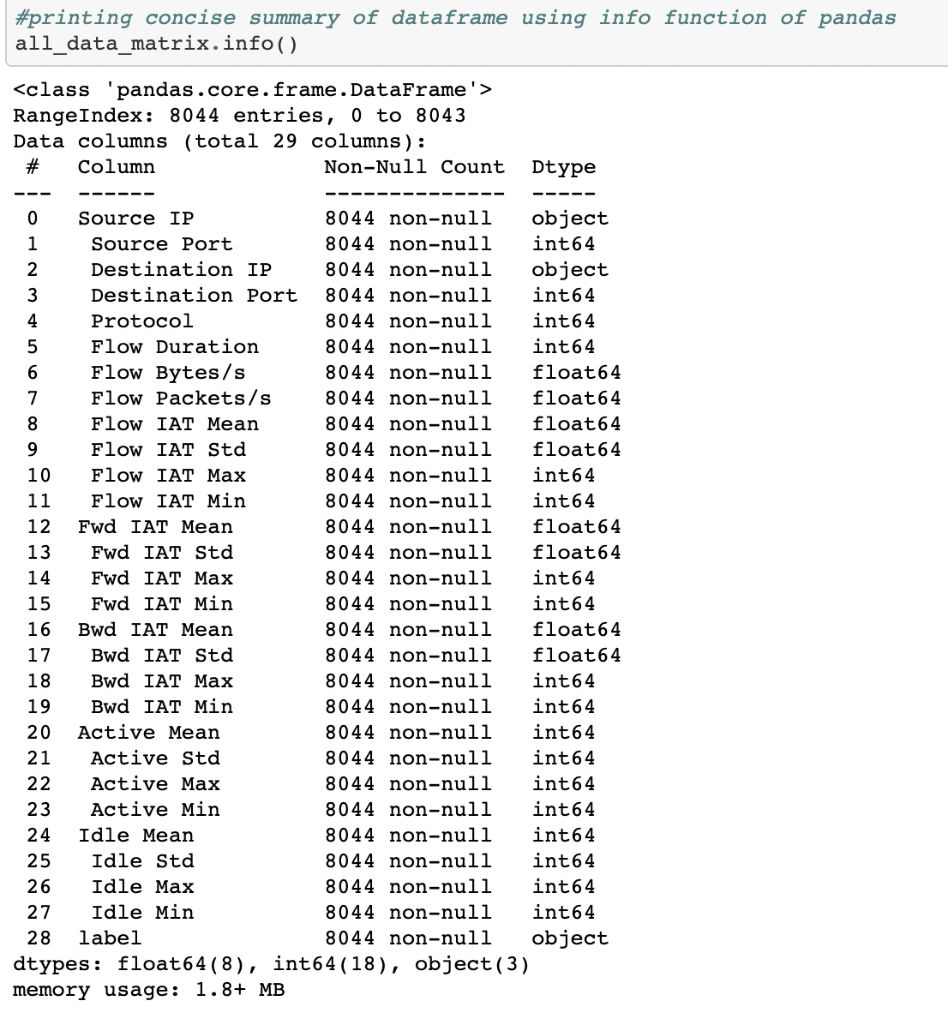
Data Exploration

Slide 10
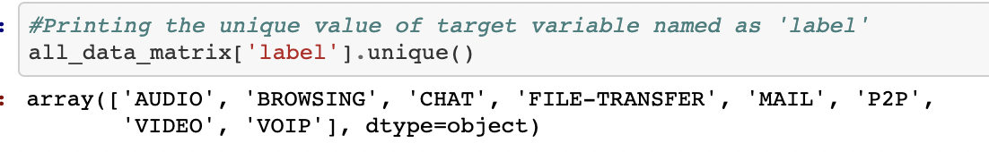
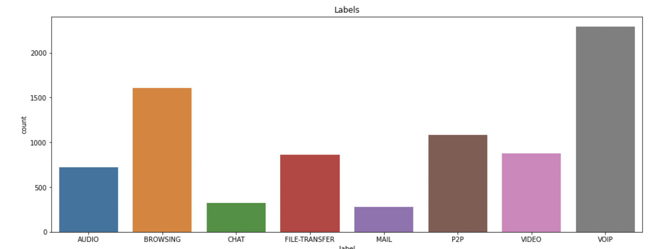
Data Exploration
Histogram of Labels

Slide 11
Data Exploration

Slide 12

Our approach - Nearest neighbor methods and vector models
The basic idea is to represent objects in a space where proximity means two items are similar.

Slide 13
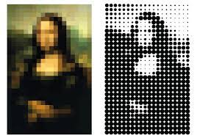
Vector Models
How does it works?
(in simple words)
Lets take an images of size 28×28. One of the most basic ways we can play around with this data set is to smash each 28×28 array into a 784-dimensional vector. And by that we can take another image also with the size of 28x28 and check with some queries the similarities between them.

Slide 14
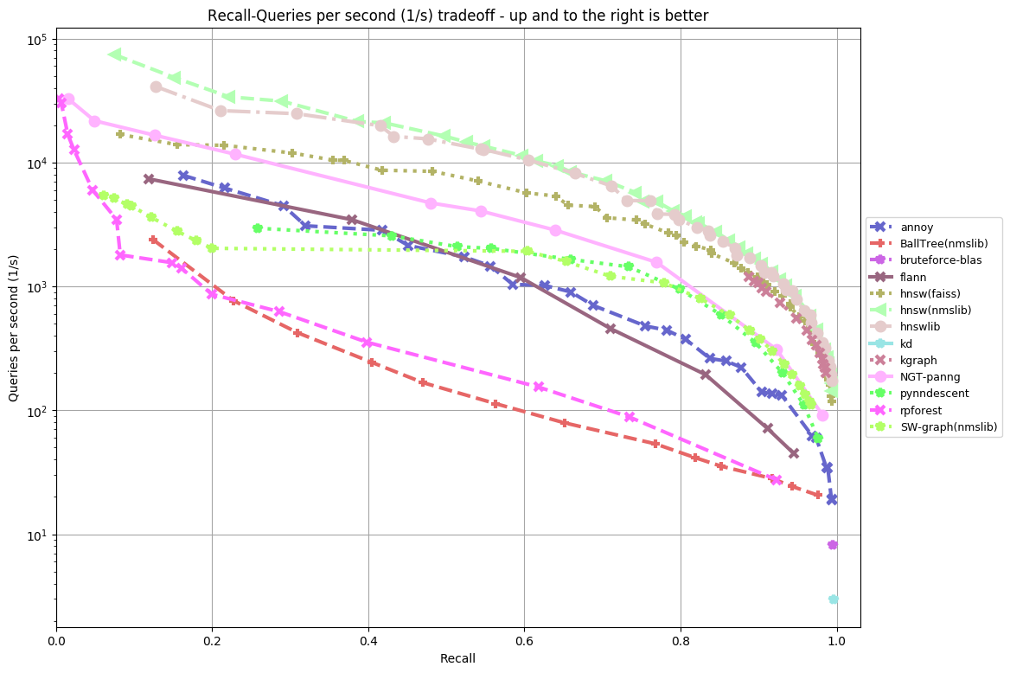
Our approach - NMSLIB
Approximate nearest neighbor search is very useful when you have a large dataset of millions of datapoints and you learn some kind of vector representation of these items.

Slide 15

Our approach - NMSLIB
In this assignment we are dealing with Non-Metric Space Library(NMSLIB) which is a cross platform similarity search toolkit for evaluation of similarity search methods.
We are working on Tor traffic dataset where our goal is to predict the correct class of the traffic type.
Using NMSLIB, K-nearest neighbor (KNN) algorithm is applied to predict the class of the input data.

Slide 16
Our approach - NMSLIB
NMSLIB provides a fast similarity search. The search is carried out in a finite database of objects {oi} using a search query q and a dissimilarity measure.
An object is a synonym for a data point or simply a point. The dissimilarity measure is typically represented by a distance function d(oi, q).
The ultimate goal is to answer a query by retrieving a subset of database objects sufficiently similar to the query q. A combination of data points and the distance function is called a search space, or simply a space.

Slide 17
Our approach - NMSLIB
Tor classification dataset contains information about the traffic on the web as an input, input has 28 features and corresponding labels which shows the type of data which it represents.
There are eight classes:
audio, chat, browsing, file transfer, mail p2p, video and VOIP .
Our task is to build a model using NMSLIB and python libraries which gives the best results on the given data.
Data needs to be prepared before applying machine learning model

Slide 18
Our approach - Implementation
Data was split into training and testing set .
As the labels are categorical, label encoding was done to convert them into vectorized form.
NMSLIB was initialized and the training data was fed to the model

Slide 19
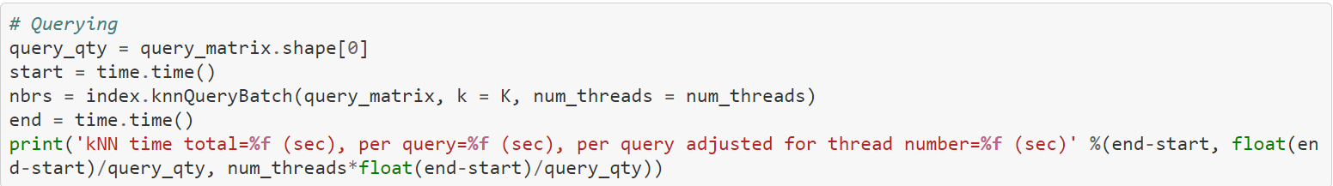
Our approach - Implementation
After we added the train points to the swgraph we query each test points in order to classify its label.

Slide 20
The results
We ran this program for 30 times and the average of the recall is 0.945.
The formula for calculatint the recall is: TP/(TP+FN) .
Applying nearest neighbors technique using NMSLIB received a recall of 95% percent. we achieved a better result and a big improvement comparing to the result that we got in the article whice was 40%-80%.
NMSLIB was implemented to solve a real world scenario which shows a nice result, by making different variations on hyperparameters and applying feature engineering techniques model accuracy can be improved more.

Slide 21
References & links
NMSLIB GitHub:
https://github.com/nmslib/nmslib
The article:
https://www.researchgate.net/publication/350061240_Application_of_Deep_Learning_on_the_Characterization_of_Tor_Traffic_using_Time_based_Features
Auteurs GitHub:
https://github.com/rambasnet/DeepLearning-TorTraffic

